Slide 1
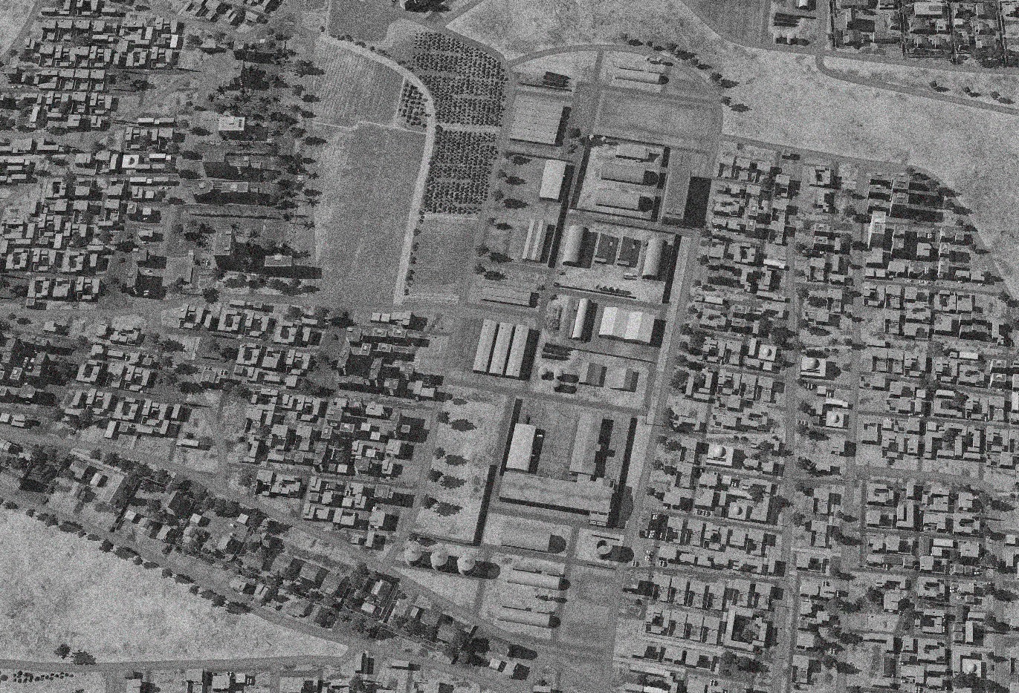

SYTGT014 DAMASCUS NW AMMUNITION FACTORY
N
9
8
10
4
5
7
6
14
11
12
DESIRED POINT of IMPACT:
DPI 12 - N33 26.965 E 36 23.791 / 2082ft / 2000lb PGM
DPI 11 - N33 26.967 E 36 23.773 / 2085ft / 2000lb PGM
DPI 10 - N33 27.048 E 36 23.806 / 2073ft / 2000lb PGM
DPI 9 - N33 27.063 E 36 23.774 / 2077ft / 2000lb PGM
DPI 8 - N33 27.046 E 36 23.770 / 2079ft / 2000lb PGM
DPI 7 - N33 27.007 E 36 23.798 / 2078ft / 2000lb PGM
DPI 6 - N33 27.013 E 36 23.778 / 2081ft / 2000lb PGM
DPI 5 - N33 27.015 E 36 23.764 / 2083ft / 2000lb PGM
DPI 4 - N33 27.015 E 36 23.748 / 2085ft / 2000lb PGM
DPI 3 - N33 26.896 E 36 23.757 / 2086ft / 2000lb PGM
DPI 2 - N33 26.894 E 36 23.720 / 2092ft / 2000lb PGM
DPI 1 - N33 26.870 E 36 23.735 / 2089ft / 2000lb PGM
2
3
1
CDC - High density civilian housing 90m from facility. Numerous buildings of religious significance within 500m of facility.

Slide 2
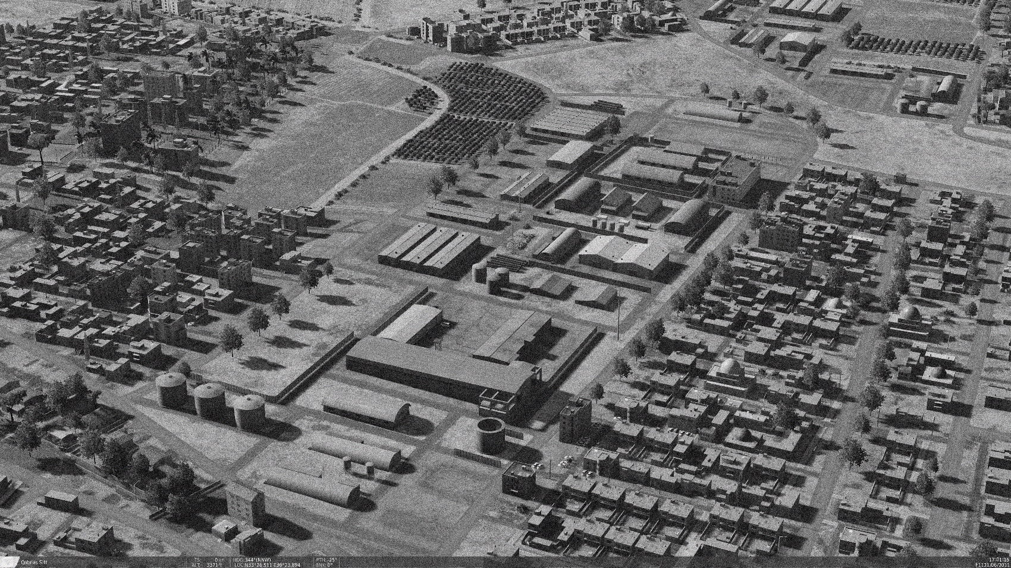
OPARTGT014 DAMASCUS NW AMMUNITION FACTORY
N
Known to be producing Surface to Air missiles for SA5, SA2, SA3, SA6 and SA11 on license from Russia.
CDC - High density civilian housing 90m from facility. Numerous buildings of religious significance within 500m of facility.

